Slide 1
" SERVICE OF REGISTRATION, EVALUATION AND ADMINISTRATION OF THE MASTER OF SUPPLIERS“
FOREIGN COMPANIES
REDNEGOCIOSCCS – Santiago Chamber of Commerce
2018

Slide 2
Santiago Chamber of Commerce (SCC)
Objective: Transformation and Increase in Productivity
Digital Transformation in the Management of Suppliers
Innovation Process, generate Greater Value to Codelco and its supplier ecosystem.
First Semester 2018: Bidding and Adjudication of the Official Registry of Suppliers of the Corporation to the Santiago Chamber of Commerce A.G www.rednegociosccs.cl replacing the Achiles-Regic system:
It will simplify purchasing decisions
It will improve the qualification of companies: Commercial, Financial, Legal, Labor and Technical

Slide 3
Santiago Chamber of Commerce (SCC)
12 years of Experience in the Administration and Operation of Registries of Multisector, Public and Private Sector Suppliers:
Registry of Suppliers of the State of Chile (ChileProveedores, the largest in the country)
Registry of Banco Estado, Central Bank, Ministry of Public Works, Indap, and Correos Chile
Multisector Registries (Banking, Financial, Retail, Industry, Telecommunications, Health, Education ...)
Experience in the Management and Integral Operation of Registry of Suppliers of high volume and impact :
150 thousand certified suppliers (largest supplier base in the country)
1 million documents per year
12 thousand multi-channel attentions per month
20,000 suppliers trained per year at the national level (face-to-face and on-line)
Consolidated Assets:
Support of the SCC which has high public and reputational trust
Human team with high expertise and high level of commercial, technological and operational platform
Network of Partner's at National and International level (Network of Chambers, Universities, Consultants, Audits, Certifiers, IT Companies, Public Organizations ...)
ISO 9001: 2015 Quality Certification, Accreditation Service and Supplier Management (8 years)

Slide 4
Enrollment Process for
New Suppliers

Slide 5
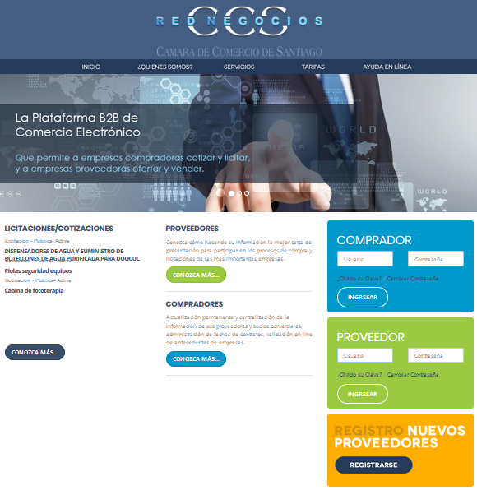
Step 1. Suppliers Sing-in
¿How to register in RedNegociosCCS?
Enter the Site: www.rednegociosccs.cl
Go to the “Registro Nuevos Proveedores” section and click on the “Registrarse” button

Slide 6
Step 2. Complete the entry form
General Data
Company Data
Select your Nationality
The main client (Mandante Principal) to be selected must be “Corporación Nacional del Cobre”
Select the Field, Category and subcategory.

Slide 7
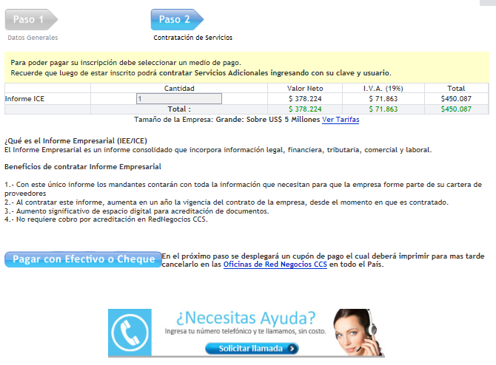
Step 3. Select Payment Form
Step 4. Make the Payment
3. The service to hire is the ICE Report (Consolidated Business Report)
*The amount to be paid will depend on the type and size of the company
4. Make the Payment
Payment: Bank Transfer according to the following bank details:

Slide 8
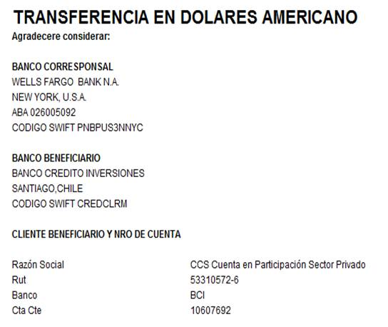
Bank Details:
Step 5: Submit the requested documents to the email :
rednegocios@ccs.cl

Slide 9
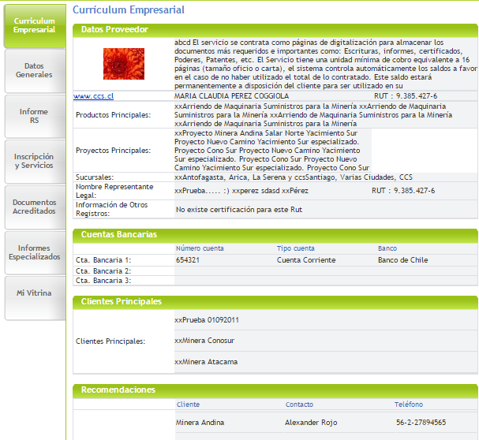
Automatic Activation of Electronic Record by Supplier
Interaction Channel
On-line
No Paper
Buyer
Supplier
Access by username and password
Access by username and password

Slide 10
With a single registration, your company and information will be visible and available for search of all the clients of the RedNegociosCCS platform (MultiMandante)
Centralization of information and/or documentation of your company in one place (less paperwork, costs, and time)
Access to the Supplier Development Program (SDP): training and comprehensive training in different business management issues
Single rate and not by category or TIER
BENEFITS OF THE REDNEGOCIOSCCS PLATFORM

Slide 11
Our Clients
Telecommunications
Sector
Retail Sector
Industrial Sector
Banking and Financial Institutions Sector
Educational Sector
Health Sector
SEP Companies
Technology
Companies
Highways Companies
Mining Companies

Slide 12
Welcome to RedNegociosCCS
If you have any questions about the registration process, you can make your inquiries through www.rednegociosccs.cI -"Ayuda en Línea" Section
Requests to RedNegociosCCS, e-mail: registrocodelco@upcom.cl,
HELP DESK 228185706

